Slide 1
Remarks for Michael Athans Memorial Service
Nils R. Sandell
July 9, 2020

Slide 2
Remarks 1
First heard of Michael when my supervisor at Bell Labs recommended Michael as PhD advisor
Wonderful teacher, mentor, supporter – and quite a character
Michael was very entrepreneurial
Consultant for Systems Control – Michael loved to go there
We planned to start a company when I graduated
A year before my graduation, Michael stopped talking about it
He became Director of LIDS and I joined the MIT faculty
Great atmosphere at LIDS
Very strong control group – Bertsekas, Mitter, Willsky, etc.
Communications group joined – Davenport, Gallagher, etc.
Michael wanted to try out control theory on practical problems
Wide variety of projects, very entrepreneurial atmosphere

Slide 3
Remarks 2
Modeling and robust control
Theory didn’t always work out
Problem was dependence on inaccurate models
Brought Gunter Stein to MIT, supervised Mike Safonov PhD thesis
Led to MIT contributions to robust control theory – controllers that work even when models are inaccurate
In these days of coronavirus, when even politicians talk about models, I think about those days
“All models are wrong, but some are useful” – George Box
”Models have limitations, stupidity does not” – Michael Athans
Transition to ALPHATECH
LIDS was a great training ground for starting a company
Michael and I founded ALPHATECH with Alan Willsky, Sol Gully and David Kleinman

Slide 4
Remarks 3
Michael was the founding Chairman of ALPHATECH
Instrumental in winning initial contracts
Loyal and supportive of a young, green CEO
Technical staff loved to work with him as consultant
Michael moved to Portugal and then to Florida
Visited him several times, first time in 2002
He loved his “farm” in the countryside outside Lisbon
Michael was unique and powerful presence to all those around him
More influential on my life than anyone outside of my wife and my parents
I will remember him always

Slide 5
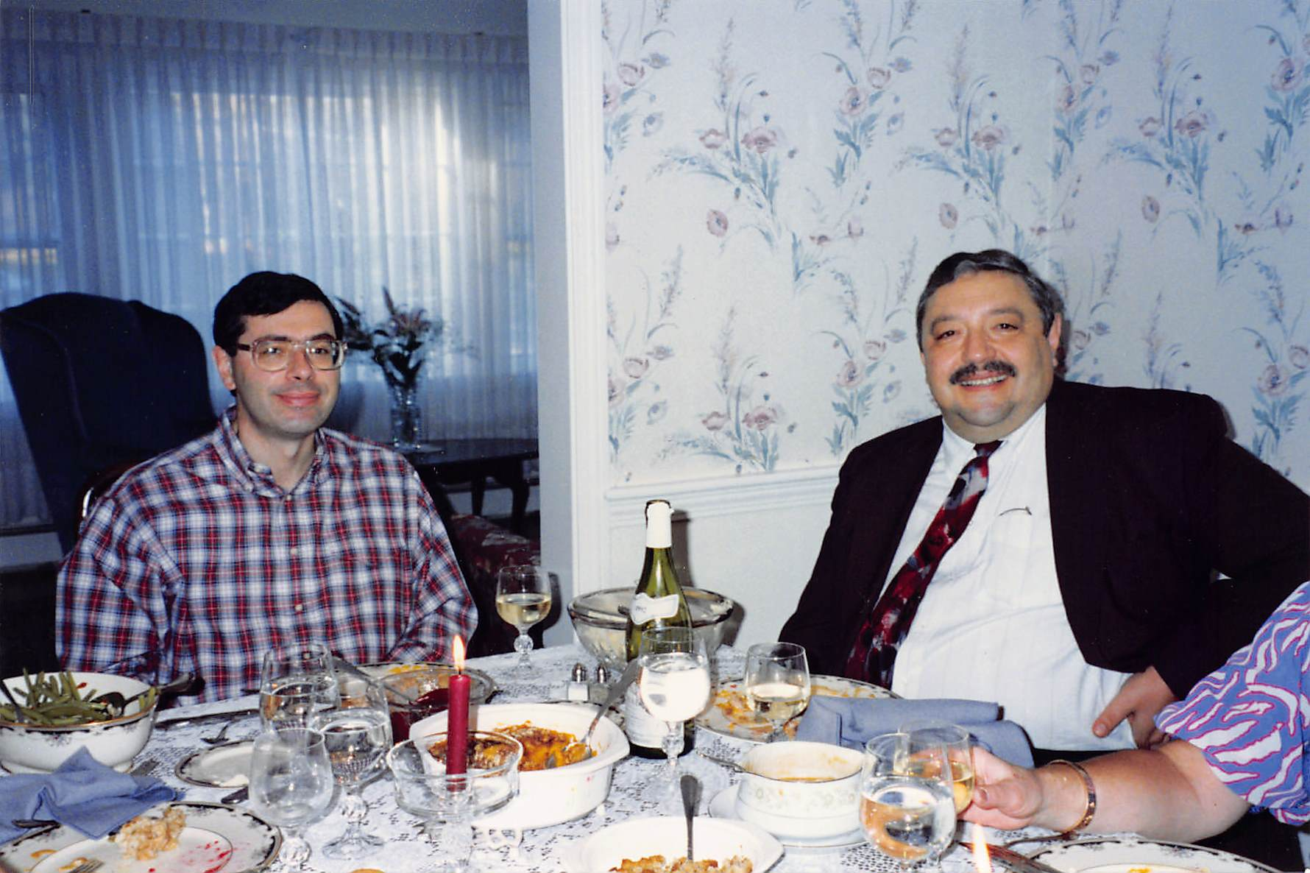
Michael at Sandell's for Thanksgiving

Slide 6
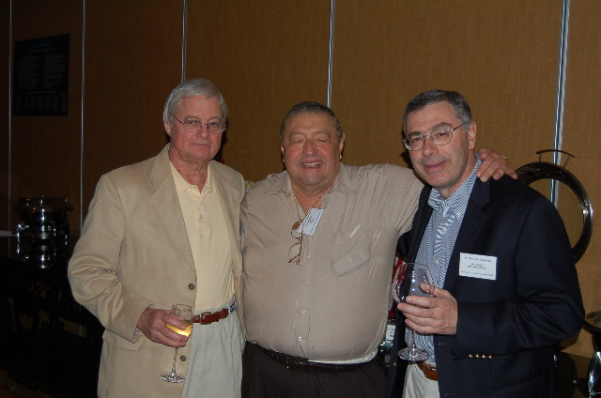
Gunter, Michael, Nils

Slide 7
ALPHATECH Board
Fred Michael Hal Bob Jack Alan Linc
Sol Gene Chuck Nils Dick

Slide 8
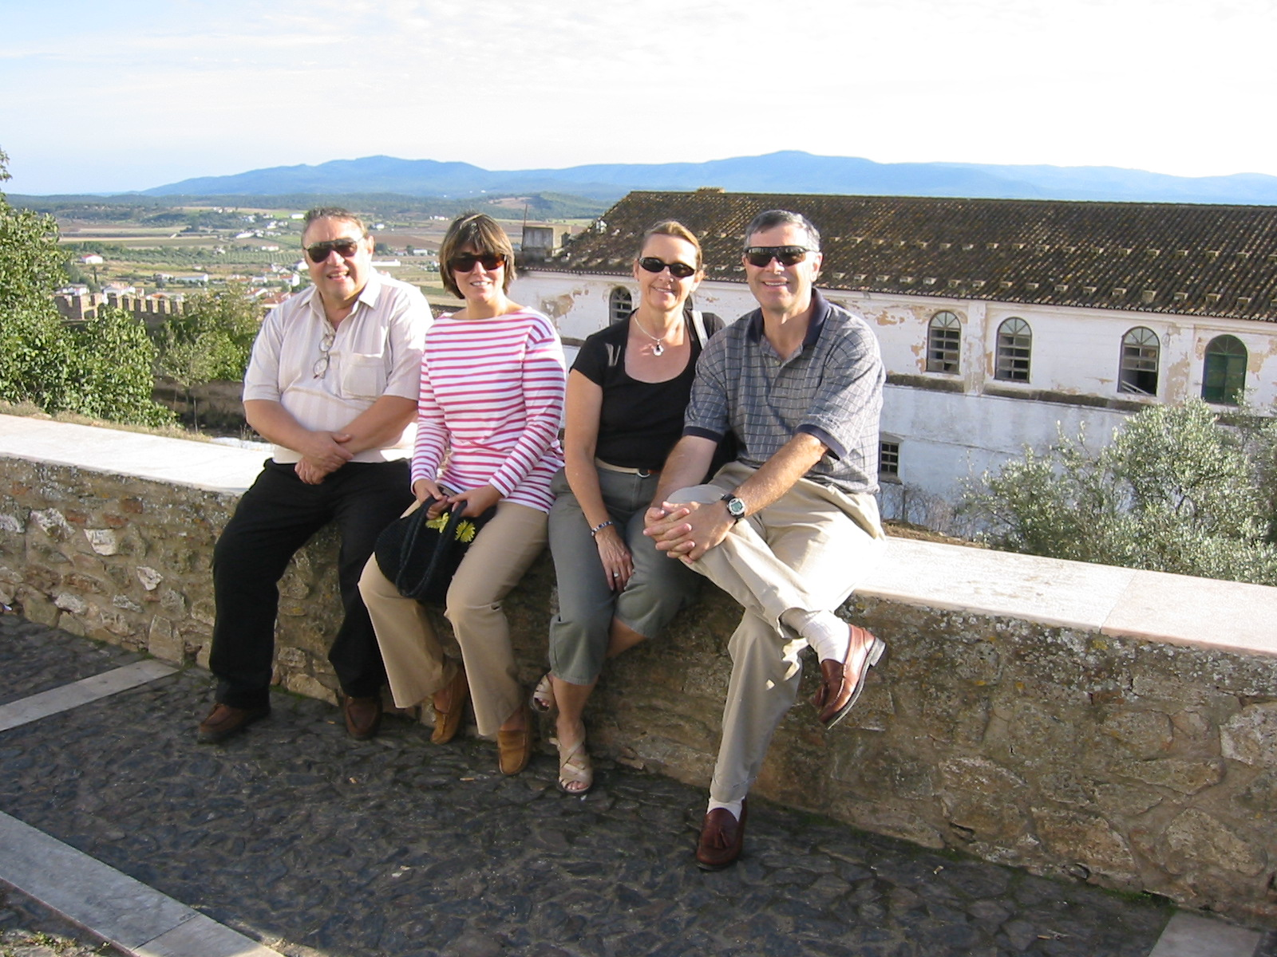
Michael, Rita, Yvonne, Nils in Portugal

